Slide 1



Do not edit
How to change the design
Join at slido.com #2249136
Presenting with animations, GIFs or speaker notes? Enable our Chrome extension
Notes:
📣 This is Slido interaction slide, please don't delete it. ✅ Click on 'Present with Slido' and the joining instructions will appear when you get to this slide.

Slide 2

Do not edit
How to change the design
How was your experience at AUST?
Presenting with animations, GIFs or speaker notes? Enable our Chrome extension
Notes:
📣 This is Slido interaction slide, please don't delete it. ✅ Click on 'Present with Slido' and the poll will launch automatically when you get to this slide.

Slide 3
Do not edit
How to change the design
What would you do if you got the chance to be readmitted in the first semester?
Presenting with animations, GIFs or speaker notes? Enable our Chrome extension
Notes:
📣 This is Slido interaction slide, please don't delete it. ✅ Click on 'Present with Slido' and the poll will launch automatically when you get to this slide.

Slide 4
Do not edit
How to change the design
If you were on the management committee, what changes would you make?
Presenting with animations, GIFs or speaker notes? Enable our Chrome extension
Notes:
📣 This is Slido interaction slide, please don't delete it. ✅ Click on 'Present with Slido' and the poll will launch automatically when you get to this slide.

Slide 5
REVISION CLASS
CSE 4267: Cloud Computing

Slide 6

What is Cloud Computing ?
Cloud computing is the delivery of on-demand computing services—such as servers, storage, databases, networking and more—over the internet ('the cloud').
Compare cloud computing to utility services like electricity or water on-demand, scalable, and pay-as-you-go

Slide 7
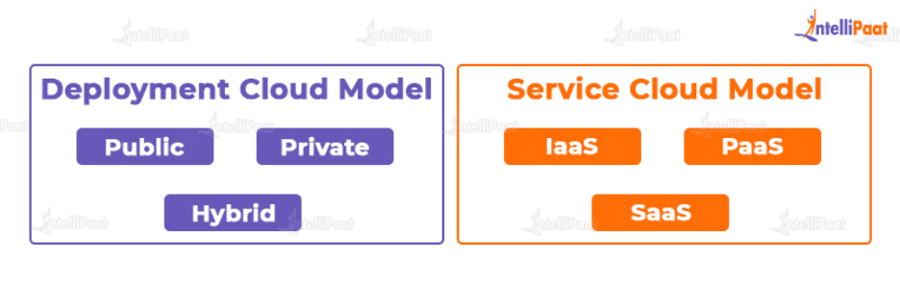
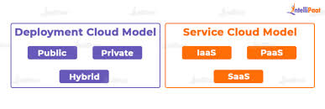
Deployment vs Service Model

Slide 8
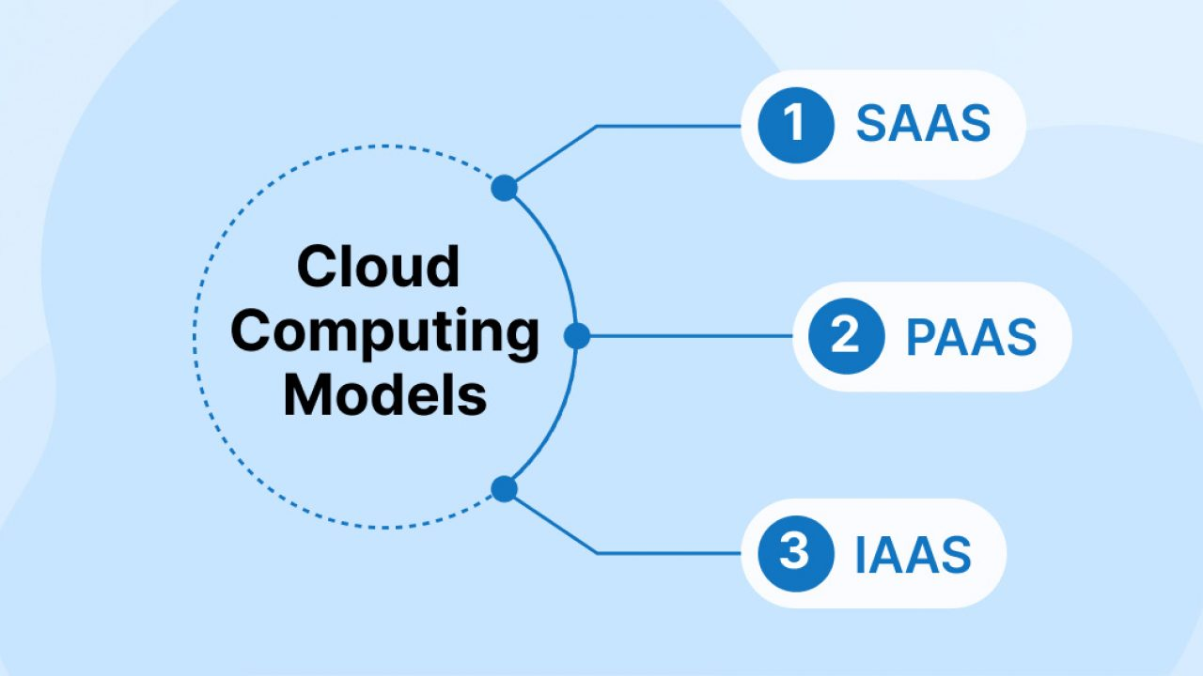
Cloud Service Models
On Premise = you buy everything and make the pizza at home
IaaS = take and bake (pick up the pizza, you cook it at home)
PaaS = pizza delivered
SaaS = dining in the restaurant

Slide 9
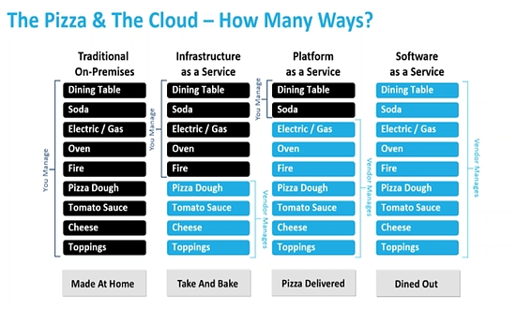

Slide 10
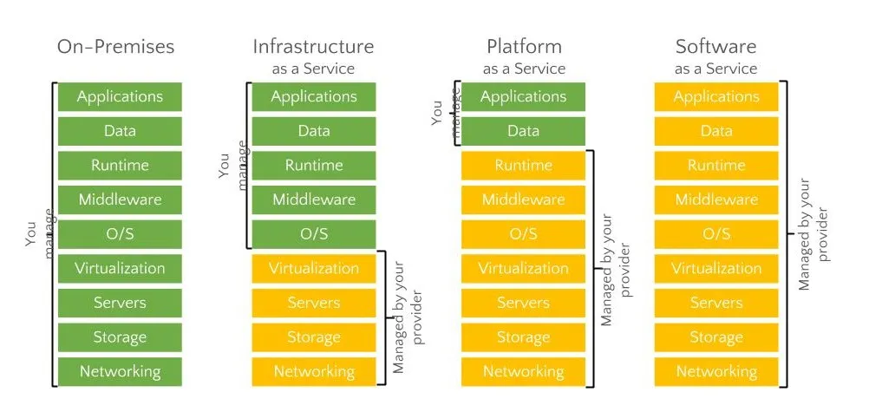
Cloud Providers Model

Slide 11

Do not edit
How to change the design
Which cloud model provides platforms for development?
Presenting with animations, GIFs or speaker notes? Enable our Chrome extension
Notes:
📣 This is Slido interaction slide, please don't delete it. ✅ Click on 'Present with Slido' and the poll will launch automatically when you get to this slide.

Slide 12
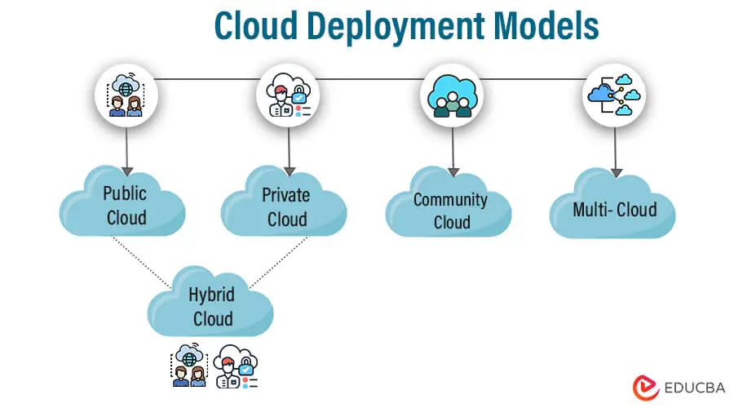
5. Cloud Deployment Models
Public Cloud: Services offered over the internet (e.g., AWS, Azure, GCP).
Private Cloud: Cloud infrastructure dedicated to a single organization.
Hybrid Cloud: Combination of public and private clouds.
Community Cloud: Shared by organizations with a common goal.

Slide 13
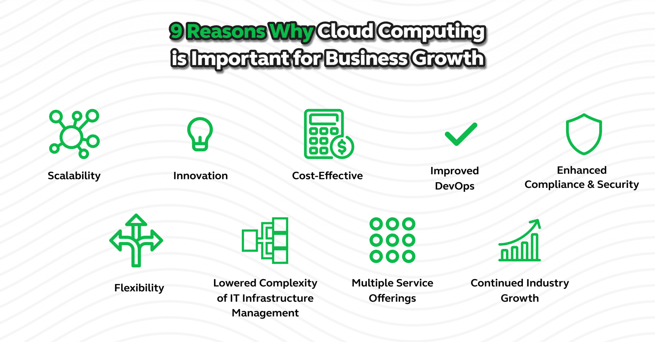
Advantages of Cloud Computing
Cost Efficiency
Scalability
Flexibility
High Availability and
Disaster Recovery

Slide 14
Do not edit
How to change the design
How does cloud computing improve scalability?
Presenting with animations, GIFs or speaker notes? Enable our Chrome extension
Notes:
📣 This is Slido interaction slide, please don't delete it. ✅ Click on 'Present with Slido' and the poll will launch automatically when you get to this slide.

Slide 15
Course Recap
Virtualization & Containerization (Docker)
Serverless Computing & API Gateways
Cloud Storage & Databases (Amazon S3, RDS)
Networking (VPC)
CDN (Amazon CloudFront)
Security & Compliance in the Cloud
Queue & Pub-Sub (Amazon SQS, SNS)

Slide 16
Virtualization & Containerization (Docker)
Virtualization: Running multiple OS instances on a single physical machine (e.g., VMware, Hyper-V).
Containerization: Lightweight, portable environments for applications (e.g., Docker, Kubernetes).
Use Cases: Microservices, DevOps, efficient resource utilization.

Slide 17
Do not edit
How to change the design
Which of the following is a containerization tool?
Presenting with animations, GIFs or speaker notes? Enable our Chrome extension
Notes:
📣 This is Slido interaction slide, please don't delete it. ✅ Click on 'Present with Slido' and the poll will launch automatically when you get to this slide.

Slide 18
Serverless Computing & API Gateways
Serverless Computing: No need to manage servers (AWS Lambda, Azure Functions).
API Gateway: Manages and secures API requests (AWS API Gateway).
Use Cases: Scalable applications, event-driven architectures.

Slide 19
Do not edit
How to change the design
Which AWS service is used to manage API requests?
Presenting with animations, GIFs or speaker notes? Enable our Chrome extension
Notes:
📣 This is Slido interaction slide, please don't delete it. ✅ Click on 'Present with Slido' and the poll will launch automatically when you get to this slide.

Slide 20
Cloud Storage & Databases (Amazon S3, RDS)
Amazon S3: Scalable object storage for files, backups, and static content.
Amazon RDS: Managed relational databases (MySQL, PostgreSQL, etc.).
Use Cases: Web applications, data analytics, disaster recovery.

Slide 21
Do not edit
How to change the design
Which AWS service is an object storage solution?
Presenting with animations, GIFs or speaker notes? Enable our Chrome extension
Notes:
📣 This is Slido interaction slide, please don't delete it. ✅ Click on 'Present with Slido' and the poll will launch automatically when you get to this slide.

Slide 22
CDN (Amazon CloudFront)
Content Delivery Network (CDN): Speeds up content delivery using global edge locations.
Amazon CloudFront: Integrates with S3, EC2, and other AWS services.
Use Cases: Website acceleration, video streaming, DDoS protection.

Slide 23
Do not edit
How to change the design
What is the main purpose of a CDN?
Presenting with animations, GIFs or speaker notes? Enable our Chrome extension
Notes:
📣 This is Slido interaction slide, please don't delete it. ✅ Click on 'Present with Slido' and the poll will launch automatically when you get to this slide.

Slide 24
Security & Compliance in the Cloud
Identity & Access Management (IAM): Controls user permissions.
Encryption: Data encryption at rest and in transit (AWS KMS, SSL/TLS).
Compliance: GDPR, ISO, HIPAA, SOC 2 for regulated industries.

Slide 25
Do not edit
How to change the design
Which AWS service is used for managing user access?
Presenting with animations, GIFs or speaker notes? Enable our Chrome extension
Notes:
📣 This is Slido interaction slide, please don't delete it. ✅ Click on 'Present with Slido' and the poll will launch automatically when you get to this slide.

Slide 26
Queue & Pub-Sub (Amazon SQS, SNS)
Amazon SQS: Message queue for decoupling applications.
Amazon SNS: Pub-sub messaging for real-time notifications.
Use Cases: Event-driven architectures, microservices communication.

Slide 27
Do not edit
How to change the design
Which AWS service is used for a message queue?
Presenting with animations, GIFs or speaker notes? Enable our Chrome extension
Notes:
📣 This is Slido interaction slide, please don't delete it. ✅ Click on 'Present with Slido' and the poll will launch automatically when you get to this slide.

Slide 28
Future Trends in Cloud Computing
AI & Machine Learning in the Cloud
Edge Computing & IoT
Multi-Cloud & Hybrid Cloud
Quantum Computing

Slide 29
Career Paths:
Cloud Engineer
DevOps Engineer
Solutions Architect
Security Specialist

Slide 30
Certifications
AWS Certified Cloud Practitioner
AWS Certified Solutions Architect
Microsoft Azure Administrator
Google Cloud Associate Engineer
Kubernetes & DevOps Certifications

Slide 31
Do not edit
How to change the design
If the election were held in 2025 in Bangladesh, which party would you vote for?
Presenting with animations, GIFs or speaker notes? Enable our Chrome extension
Notes:
📣 This is Slido interaction slide, please don't delete it. ✅ Click on 'Present with Slido' and the poll will launch automatically when you get to this slide.

